Slide 1
What can be done with Python
Using Python for Quantitative Analysis

Slide 2
Chapter Objectives
In this chapter, we will:
Examine why Python is used in Quantitative Financial Analysis
Discuss when Python can be used to help the Quantitative Analyst
Introduce useful Python packages
Build tools to get many CSV files or Excel spreadsheets into one

Slide 3
Chapter Concepts
Industry wide move to Python
What can Python do
Moving many data files into Excel at once
Python Web Scraping (separate course)
Python to monitor prices
Email or text alerts from Python
Five year rolling averages
Chapter Summary

Slide 4
Industry wide move to python
Many Wall Street organizations are asking their analysts to be able to code in Python https://www.enterprisetimes.co.uk/2018/10/10/jpmorgan-wants-its-financial-analysts-to-be-able-to-code/
Because of its wide support and availability of powerful modules and packages Python has become a language of choice in finance. https://www.quora.com/Which-program-is-better-for-the-finance-world-R-or-Python
Python is relatively easy to learn, even when doing complex tasks because there are so many proven and tested packages. https://news.efinancialcareers.com/se-en/327770/python-for-finance
Python is popular in fintech and financial analyst task automation https://stxnext.com/blog/2018/09/13/why-python-should-be-technology-choice-your-fintech/

Slide 5
Chapter Concepts
Industry wide move to Python
What can Python do
Moving many data files into Excel at once
Python Web Scraping (separate course)
Python to monitor prices
Email or text alerts from Python
Five year rolling averages
Chapter Summary

Slide 6
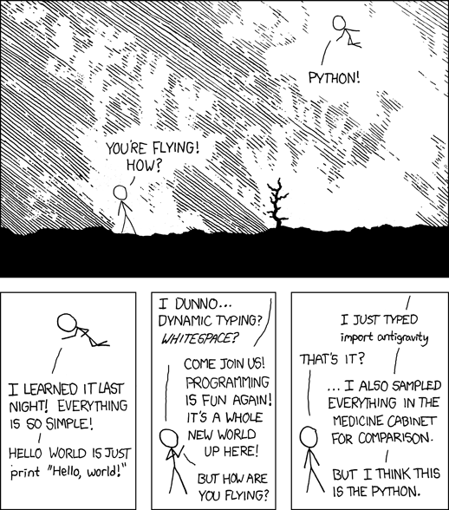
What Can Python Do?
Python can do just about anything
https://xkcd.com/353
print(“Hello World!”)
In Python3

Slide 7
Chapter Concepts
Industry wide move to Python
What can Python do
Moving many data files into Excel at once
Python Web Scraping (separate course)
Python to monitor prices
Email or text alerts from Python
Five year rolling averages
Chapter Summary

Slide 8
Python can move many data files into Excel at once
In an upcoming section of the course, students will work with code that bring Commas Separated Values (CSV) files into an Excel sheet.
Python can combine many CSV or other Excel files into one Excel sheet with one simple action.
Python can combine many CSV or Excel files into multiple Excel sheets within the same workbook.
Each sheet can be programmatically named as they are added to an Excel workbook.
Formatting and formulas can be added to a worksheet or multiple worksheets within an Excel workbook.
The work we will do with Excel is representative of what can be done in Python and you will receive that code. In the next couple slides, let’s explore other possibilities. What else can be done with Python to help the quantitative analyst?

Slide 9
Chapter Concepts
Industry wide move to Python
What can Python do
Moving many data files into Excel at once
Python Web Scraping (separate course)
Python to monitor prices
Email or text alerts from Python
Five year rolling averages
Chapter Summary

Slide 10
Python Web Scraping (separate course)
In a separate course, we show students how to scrape financial data or prices from web pages.
A Python package called beautifulsoup can be used to turn the html of a webpage into values Python can extract and put into files analysts can use. https://pypi.org/project/beautifulsoup4/
By looping though a list of URLs dozens or hundreds of similar web pages containing financial data can be scraped at once, including looking through footnotes.
PDF files and Microsoft Word documents can be scraped with Python packages including PyPDF2 and Python-Docx https://automatetheboringstuff.com/chapter13/
Repetitive work like clicking a link and downloading, then clicking another link and downloading data again, and again, can by automated with Python using Selenium. https://medium.freecodecamp.org/better-web-scraping-in-python-with-selenium-beautiful-soup-and-pandas-d6390592e251
Notes:
Sometimes all that is required for output is a discrete value
Classification is a better technique for such problems

Slide 11
Chapter Concepts
Industry wide move to Python
What can Python do
Moving many data files into Excel at once
Python Web Scraping (separate course)
Python to monitor prices
Email or text alerts from Python
Five year rolling averages
Chapter Summary

Slide 12
Python to monitor prices
An analyst might want to know the retail price of goods to see if margins are being maintained.
While this could be done manually each day, week, or quarter, creating a Python script could save an analyst a great deal of time.
A fixed income analyst might look over the same web sites over and over looking for changes. The same techniques that are used to monitor prices could be used to follow changes.

Slide 13
Chapter Concepts
Industry wide move to Python
What can Python do
Moving many data files into Excel at once
Python Web Scraping (separate course)
Python to monitor prices
Email or text alerts from Python
Five year rolling averages
Chapter Summary

Slide 14
Send an email or text with Python
When a file is put in a directory, a condition is met, or for any reason Python can send out an email or text message.
Be sure to use this feature sparingly to not overwhelm inboxes.
Example cases and code are available at:
https://automatetheboringstuff.com/chapter16/
https://www.fullstackpython.com/blog/send-sms-text-messages-python.html
https://www.twilio.com/docs/libraries/python

Slide 15
Chapter Concepts
Industry wide move to Python
What can Python do
Moving many data files into Excel at once
Python Web Scraping (separate course)
Python to monitor prices
Email or text alerts from Python
Five year rolling averages
Chapter Summary

Slide 16
Five year rolling average of returns
Looking at returns in different time frames can be tedious to set up
Python can be used to do those time-consuming steps to look at returns over rolling intervals
While some might use this as a “trading strategy” the same ideas and similar code can be used for analysis
https://www.learndatasci.com/tutorials/python-finance-part-3-moving-average-trading-strategy/
Python pandas can be particularly helpful in this area.
https://chrisalbon.com/python/data_wrangling/pandas_moving_average/

Slide 17
Instructor Demo and Code - Excel
Let’s get back to that detailed coding examples we discussed earlier automating tasks with files and Excel using Python.
Python Jupyter Notebooks will be used and made available to students to show working Python that can help automate the tasks of an analyst.
Notes:
The details of TensorFlow will come later – here just mention it’s a very high level view and we will show how it works later

Slide 18
What might you use Python to Automate?
Now that we have discussed what Python, can do let’s make a list of what we might want Python to do.
Do It Now

Slide 19
Chapter Summary
In this chapter, we have:
Examined the industry move to Python
Introduced automating file tasks in Excel
Discussed Web Scraping (separate course)
Looked at having Python send automated emails or texts
Considered issues involved in rolling average analysis

